Slide 1

Interpersonal Communication at Workplace: Dynamics of communication:
Semester 3 – Professional Communication Skills (303193203)

Slide 2
Learning Objectives
Explain the importance and types of interpersonal communication.
Identify verbal and nonverbal cues in workplace interactions.
Practice active listening and empathy for effective communication.
Apply techniques for conflict resolution and cultural sensitivity.
Improve professional relationships through effective feedback and trust-building.

Slide 3
Introduction
The Silent Conversation Activity (5 minutes)
Step 1: Silent Pair Activity
Ask students to pair up and sit face-to-face. Give them this instruction:
For the next 60 seconds, you must try to ‘communicate’ with your partner without using any words—no speaking, texting, or writing. Just use your eyes, facial expressions, and body language to express a simple message like:
‘I’m happy to see you’ or ‘You took my pen.’ Ready? Go!

Slide 4
Introduction
Step 2: Ask These Questions:
What did you try to express?
How did you do it without words?
Could your partner understand you? How?
Was it comfortable or awkward?
Transition into the Topic:
What just happened was interpersonal communication—but without the words. You used non-verbal cues, facial expressions, and eye contact.
Now imagine how much more powerful communication becomes when we combine this with words, active listening, and emotional awareness.

Slide 5
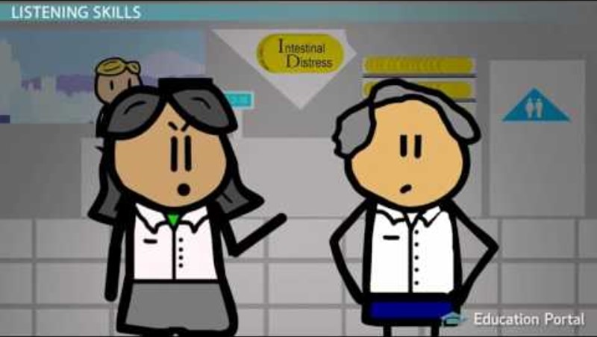
Introduction
What is Interpersonal Communication?
Interpersonal Communication is the process of exchanging ideas, thoughts, emotions, and information between two or more people, using both verbal (spoken or written words) and non-verbal (body language, tone of voice, facial expressions) methods.
It is a two-way process where both the sender and the receiver actively participate to create understanding and build relationships.

Slide 6
Interpersonal Communication at the Workplace
Interpersonal communication at the workplace refers to the exchange of information, ideas, thoughts, and emotions between colleagues, teams, and management through verbal and non-verbal means. It plays a vital role in ensuring smooth workflow, collaboration, and a healthy work environment.
Example:
During a team meeting, the project manager explains the new task clearly (verbal communication) while maintaining eye contact and using hand gestures (non-verbal communication). Team members listen carefully and ask questions to ensure they understand. This helps the team work smoothly and avoid mistakes.

Slide 7
Verbal Communication
Involves spoken and written messages used to share information.
Key elements include:
Clarity: Speaking clearly so the message is easily understood.
Tone: The attitude or emotion behind the words, which affects how the message is received.
Word Choice: Using appropriate and precise words to convey the right meaning.
Organized ideas help make the message logical and easy to follow.
Active listening is crucial to understand the speaker fully and respond effectively.

Slide 8
Nonverbal Communication
Nonverbal Communication
Includes facial expressions, gestures, tone of voice, and posture.
Often complements verbal messages by reinforcing meaning or contradicts them when there is mixed communication.
Nonverbal cues can vary widely across different cultures, so understanding cultural differences is important to avoid misunderstandings.

Slide 9
Active Listening
Giving full attention to the speaker without distractions.
Signs of active listening include:
Maintaining eye contact.
Nodding to show understanding.
Using verbal affirmations like “I see,” “Yes,” or “Go on.”
Benefits:
Improves clarity and understanding..
Shows respect to the speaker
Helps reduce misunderstandings and conflicts.

Slide 10
Empathy in Communication
Understanding and sharing others’ feelings and perspectives.
Helps to build strong connections and trust between people.
Empathy means truly putting yourself in someone else’s shoes, while sympathy is feeling sorry for someone but staying emotionally distant.
Example:
When a colleague shares their workload stress, you listen carefully and say, “I understand how tough this is for you. How can I help?”
A friend is upset about a failed exam, and instead of just saying “That’s too bad,” you say, “I’m really sorry you’re feeling this way. Let’s figure out how to improve together.”

Slide 11
Feedback
Constructive Feedback: Focuses on improvement, given respectfully.
Criticism: Points out faults without support, can demotivate.
Importance
Improves communication and performance
Builds trust and encourages growth
Technique: Sandwich Method
Positive ➝ Suggestion ➝ Positive
Example: Good work! Try to speak a bit slower. You’re improving well!

Slide 12
Respect and Courtesy
Use polite language, a respectful tone, and positive gestures.
Show cultural respect and maintain personal boundaries.
Encourage inclusive and open dialogue where everyone feels heard and valued.

Slide 13
Conflict Resolution
Common Conflicts: Misunderstandings, poor communication, role confusion.
Resolution Strategies:
Active listening: Fully concentrate on the speaker, showing understanding through gestures and feedback.
Calm, respectful dialogue: Speak politely and stay composed, even during disagreements.
Clarifying issues and finding common ground: Ask questions to understand problems clearly and look for solutions that satisfy everyone involved.
Win-Win Approach: Aim for solutions that benefit all parties and maintain relationships

Slide 14
Adaptability in Communication
Adapt your communication to fit the styles and needs of different people and situations.
Use a flexible tone, choice of words, and approach to connect effectively.
Flexibility helps create trust and smooth collaboration.
Being adaptable is vital when working with varied teams and clients.

Slide 15
Trust and Openness
Honesty and transparency build strong communication.
Maintain confidentiality and be reliable in your actions.
Encourage open and respectful conversations.
Fosters a safe, collaborative, and productive environment.

Slide 16
Cultural Awareness and Sensitivity
Recognize and respect different cultural communication styles and values.
Avoid stereotypes and assumptions.
Promote inclusivity by being open-minded and empathetic.
Builds stronger relationships in diverse teams.

Slide 17
Importance in the Workplace
Communication is key to effective teamwork and strong leadership.
It ensures everyone understands their roles and works towards common goals.
Enhances collaboration and boosts productivity
Clear communication allows teams to share ideas and solve problems faster.
Helps reduce conflicts and improves employee morale
Open dialogue creates a positive environment where issues are addressed early.

Slide 18
Theories of Interpersonal Communication
Recognizing cultural communication styles and values helps us understand different ways people express themselves.
Avoiding stereotypes and assumptions prevents misunderstandings and builds respect.
Promoting inclusivity creates open, effective communication across diverse groups.
Theories of Interpersonal Communication
Theories explain how people interact and connect considering culture, context, and individual differences.
They guide us in adapting communication styles to improve relationships.

Slide 19
Nonverbal Communication in the Workplace
Nonverbal cues can match or conflict with spoken words.
This affects how clearly your message is understood.
Reading body language shows true feelings and intent.
It helps avoid misunderstandings.
Being aware of your nonverbal signals improves communication.
It builds trust and connection with others.

Slide 20
Emotional Intelligence (EI)
Components: Self-awareness, self-regulation, empathy, social skills.
These skills help individuals understand and manage their own and others’ emotions.
Role in Workplace Communication: Helps manage emotions and build strong relationships.
Leads to better teamwork, collaboration, and conflict resolution.
EI and Leadership: Essential for inspiring teams and handling conflicts effectively.
Leaders with high EI create positive work environments and motivate others.

Slide 21
Cultural Sensitivity at Work
Embrace diversity in communication styles and perspectives.
This fosters an inclusive and supportive workplace.
Show respect for different cultural norms and practices.
Respect helps build trust and positive relationships.
Be aware of common cultural misunderstandings and learn how to avoid them.
Awareness prevents conflicts and improves teamwork.

Slide 22
Activity 1 - Role Play Workplace Communication
Instructions:
Students form pairs or groups.
Each group is given a workplace scenario (e.g., manager and employee discussion).
Participants act out their roles, focusing on clear, respectful, and effective communication.
Debrief & Discussion:
Groups reflect on their experience and discuss what communication techniques worked or needed improvement.
Facilitator highlights key learning points for better workplace interactions.

Slide 23
Activity 2 - Communication Style Self-Assessment
Instructions:
  Each student completes a self-assessment inventory to evaluate how they communicate.
  They identify their strengths and areas where they can improve.
  Students then participate in a group discussion to share their results and learn from peers.
This activity encourages self-awareness and promotes better communication skills.

Slide 24
Case Study Discussion
Objective: Analyze real workplace communication challenges to apply learning.
Instructions:
  Present students with a real-life workplace scenario.
  Students identify the main communication problems in the case.
  Discuss how communication theories and strategies can help resolve these issues.
This activity bridges theory with practice, enhancing problem-solving skills.

Slide 25
Conclusion
Recap of key points:
• Basics and principles of interpersonal communication.
• Importance in the workplace context.
• Relevant theories and role of emotional intelligence.
Encourage reflection on personal communication strengths and areas for growth.

Slide 26
Learning Outcomes
By the end of this two-hour session, students will be able to:
Define interpersonal communication and explain its key components (verbal, nonverbal, feedback, empathy, etc.).
Apply active listening, empathy, and feedback techniques in workplace scenarios.
Analyze different communication styles and adapt based on context and cultural sensitivity.
Demonstrate effective strategies for conflict resolution and team collaboration.
Evaluate interpersonal communication theories and relate them to real-world workplace situations.

Slide 27
Thank You

